Slide 1
Language Recognizer
Rust
Whitney Garbutt
Paul Yong
Asher Mckoy
Raphael Cal

Slide 2
BNF GRAMMAR
<program> → begin <stmt_list> end
<stmt_list> → <stmt> | <stmt> ; <stmt_list>
<stmt> → <var> = <expression>
<expression> → <var> + <var> | <var> - <var> | <var>
<var> → x | y | z

Slide 3
BNF GRAMMAR CONT’D
Shows the rules for the program
The input must start with “begin” and terminate with “end”
There can be one or multiple <stmt_list>
Each of those are made up of a <stmt>
<stmt> consists of <var> = <expression>
An expression must take the form of: <var> + <var>, <var> - <var>, or <var>
A <var> can only be x, y, or z

Slide 4
Language
Rust
Started in 2006 by Graydon Hoare, employee of Mozilla.
Systems programming language sponsored by Mozilla.
Designed to be a safe, concurrent, and practical language.
Syntactically similar to C++, but it is designed for better memory safety while maintaining the performance.
Runs fast, prevents segfaults, and guarantees thread safety.

Slide 5
Compiler/Interpretor
Compiler runs on and compiles to many platforms.
3 categories of compilers for different platforms: guaranteed to work, guaranteed to build, not guaranteed.
To install compiler, just run the executable on rust.rs website.
Version 1.22 (September 15, 2017)

Slide 6
Objective
Create a language recognizer program.
Program is to display the BNF grammar and ask for input.
The string must start with begin and terminate with end
The string must consist of valid statements that must take the following form: <var> = <expression>
An <expression> can be of the following forms:
<var> + <var> | <var> - <var> | <var>
A <var> can only be x, y, or z

Slide 7
PROCESS FLOW
The first thing the program does it to display the BNF Grammar, and then asks for input from the user.
The input is then checked to see if it starts with begin and ends with end.
If this is successful, the input string is split by white-spaces into several substrings and subsequently placed into a vector.
The derivation process starts from the last substring and moves toward the first (Rightmost Derivation)

Slide 8
PROCESS FLOW CONT’D
Each substring is verified that the characters are valid operations and variables and that they are in the correct places.
If any error occurs, an appropriate error message will be displayed, and the user will be prompted to enter another string.
If the derivation is successful, a parse tree will be drawn.

Slide 9
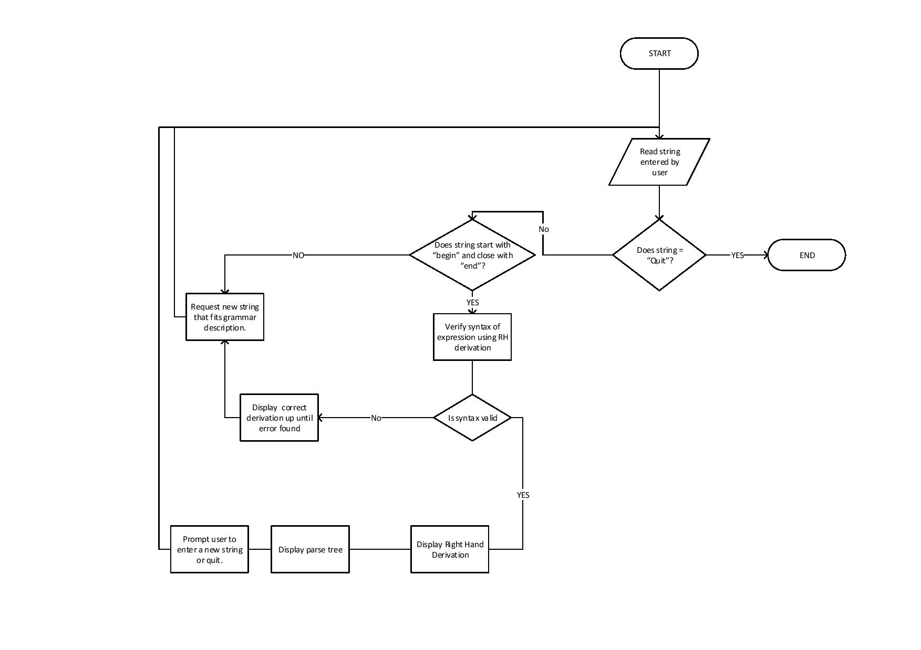
FLOW CHART

